Slide 1
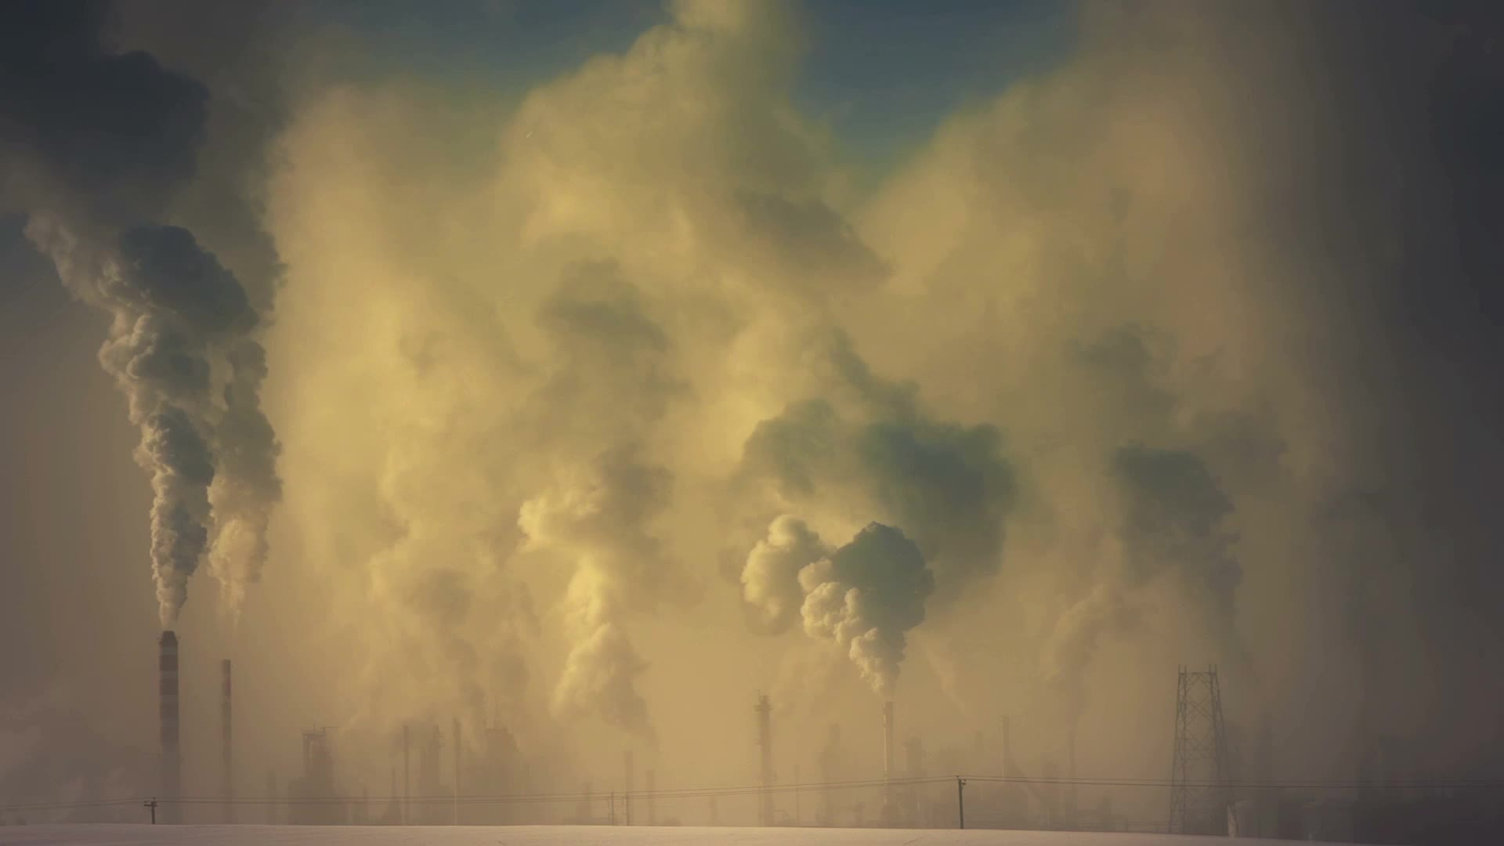
Rising Water: The Global Challenge of Sea Level Change

Slide 2

GROUP DETAILS
Alan Babu Manuel
MSc Data Analytics
x23157143@student.ncirl.ie
Melin Mary Lalu
MSc Data Analytics
x23185104@student.ncirl.ie
Vishnunath Nharekkat
MSc Data Analytics
x22234217@student.ncirl.ie

Slide 3

INTRODUCTION
Sea level rise is a critical consequence of climate change. As global temperatures increase, glaciers melt, and polar ice sheets shrink, our oceans expand. This expansion leads to a higher increase in sea levels and affects the coastlines, communities, and ecosystems worldwide.
Air pollution and CO2 emission indirectly accelerates the melting of glaciers and ice sheets.
The warmer climate due to the high level of greenhouse gases in the atmosphere causes the land-based ice to melt and release this melted water into the oceans. This additional water further raises the sea level.

Slide 4

DATA SETS
We have chosen three datasets. One is a structured dataset in the CSV format and the other two are unstructured JSON data.
The two datasets are taken from Kaggle, and the third data set is from the Global Warming official site.
The structured datasets explain the sea level rise in the world
The two unstructured datasets explain the air pollution and CO2 emissions in the world.

Slide 5
EXPLANATION OF DATA SET

Slide 6
DATA SET 1-SEA LEVEL RISE
This dataset explains the amount of sea level rise in various countries.
Sea level rise is an alarming consequence of climate change.
The main causes of sea level rise is the thermal expansion of seawater along with the melting of land-based ice such as glaciers and ice sheets.
Sea level rise is mainly affected on coastal communities by resulting in high-level floods, infrastructure damage, and increased storm surge risk.

Slide 7
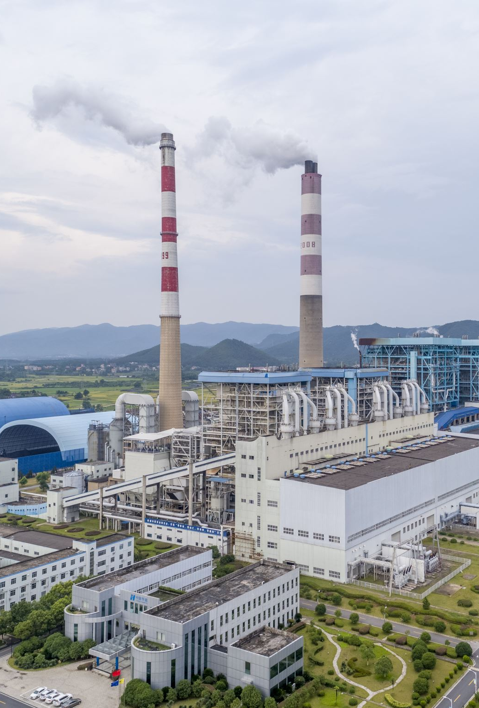
DATA SET 2- AIR POLLUTION
This dataset explains the air quality parameters such as AQI (Air Quality Index) values, categorized by different pollutants like CO, Ozone, NO2, and PM2.5, across various countries and cities.
Air pollution is a pressing environmental issue with far-reaching consequences.
The quality of the air we breathe directly impacts human health, ecosystems, and the overall well-being of our planet.
Air pollution affects sea level rise by accelerating the melting of land-based ice. The warming caused by air pollution exacerbates ice melt in polar regions.

Slide 8
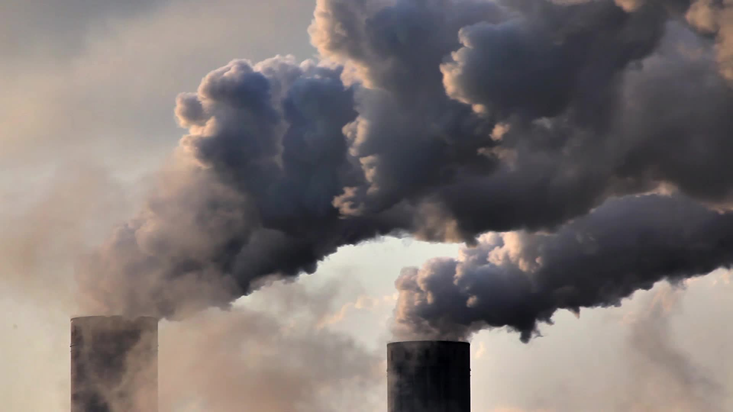
DATA SET 3-CO2 EMISSION
This data set explains the amount of CO2 emission of various countries from 1740 to 2024.
CO2 emissions have significant environmental impacts.
The amount of CO2 in the atmosphere contributes to the greenhouse effect, which traps heat and causes global warming.
CO2 emissions cause rising global temperatures, sea level rise, changes in weather patterns, and ecosystem disruptions.
Climate change can have long-term detrimental repercussions for human health, agriculture, biodiversity, and socioeconomic systems.

Slide 9


DATA PROCESSING
We have chosen MongoDB as our database which is a NoSQL database tool.
The schema-less architecture of MongoDB accommodates flexibility, allowing for easy adaptation to evolving data structures.
MongoDB’s scalability and quick retrieval capabilities make it an apt choice for storing large datasets.

Slide 10

DATA PRE-PROCESSING
It is important to clean data and modify raw data before putting it into a machine learning algorithm.
Pre-processing helps to improve the model's accuracy.
We have checked the dataset for null values and duplicate rows.
Suppose there are any null values, we could either fill those values with mean values or drop the entire column in case of a large number of missing values.

Slide 11

EXPLORATORY DATA ANALYSIS

Slide 12
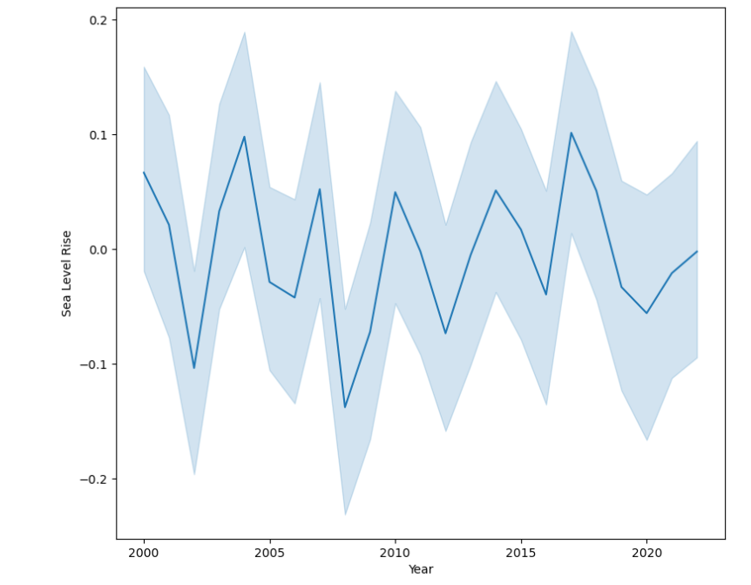
The line plot shows the yearly sea level rise on each country.

Slide 13
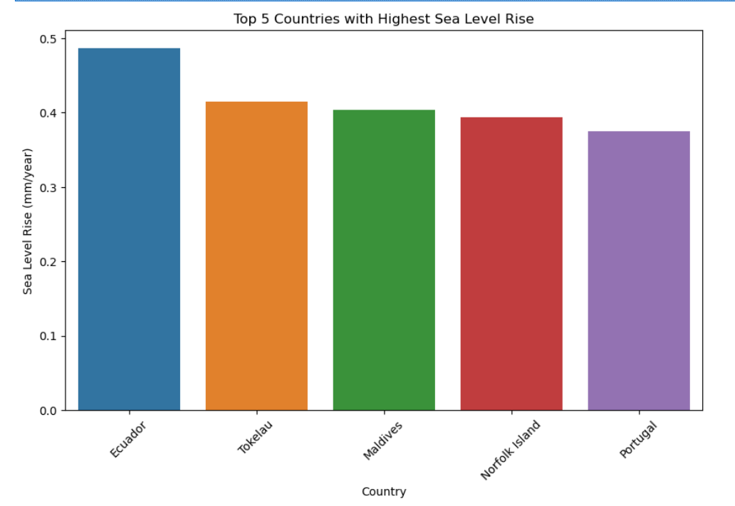
The bar plot shows the top five country which have the highest sea level rise.

Slide 14
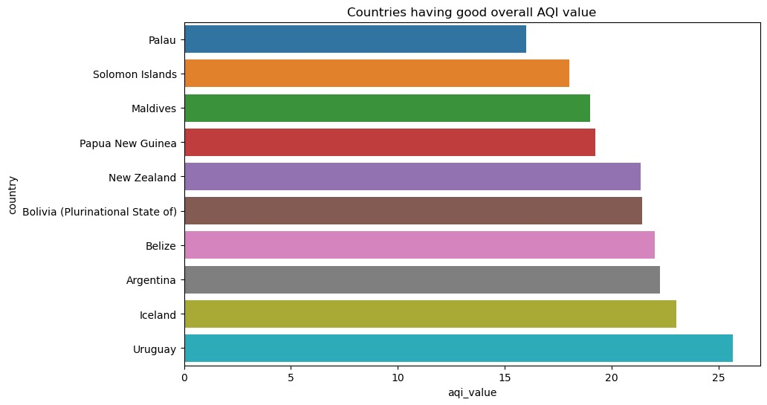
This bar plot shows the countries which have good AQI value

Slide 15
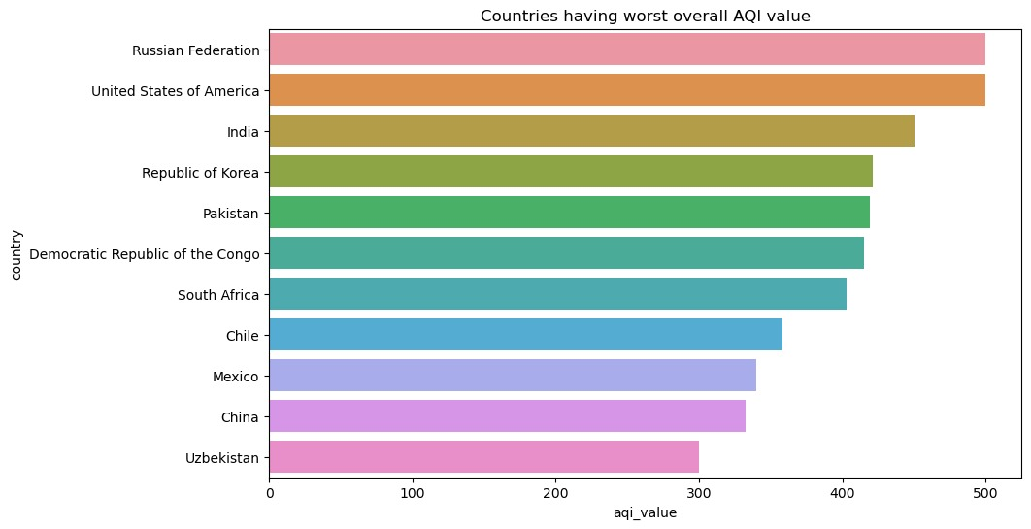
The bar plot shows the countries which have worst AQI value.

Slide 16
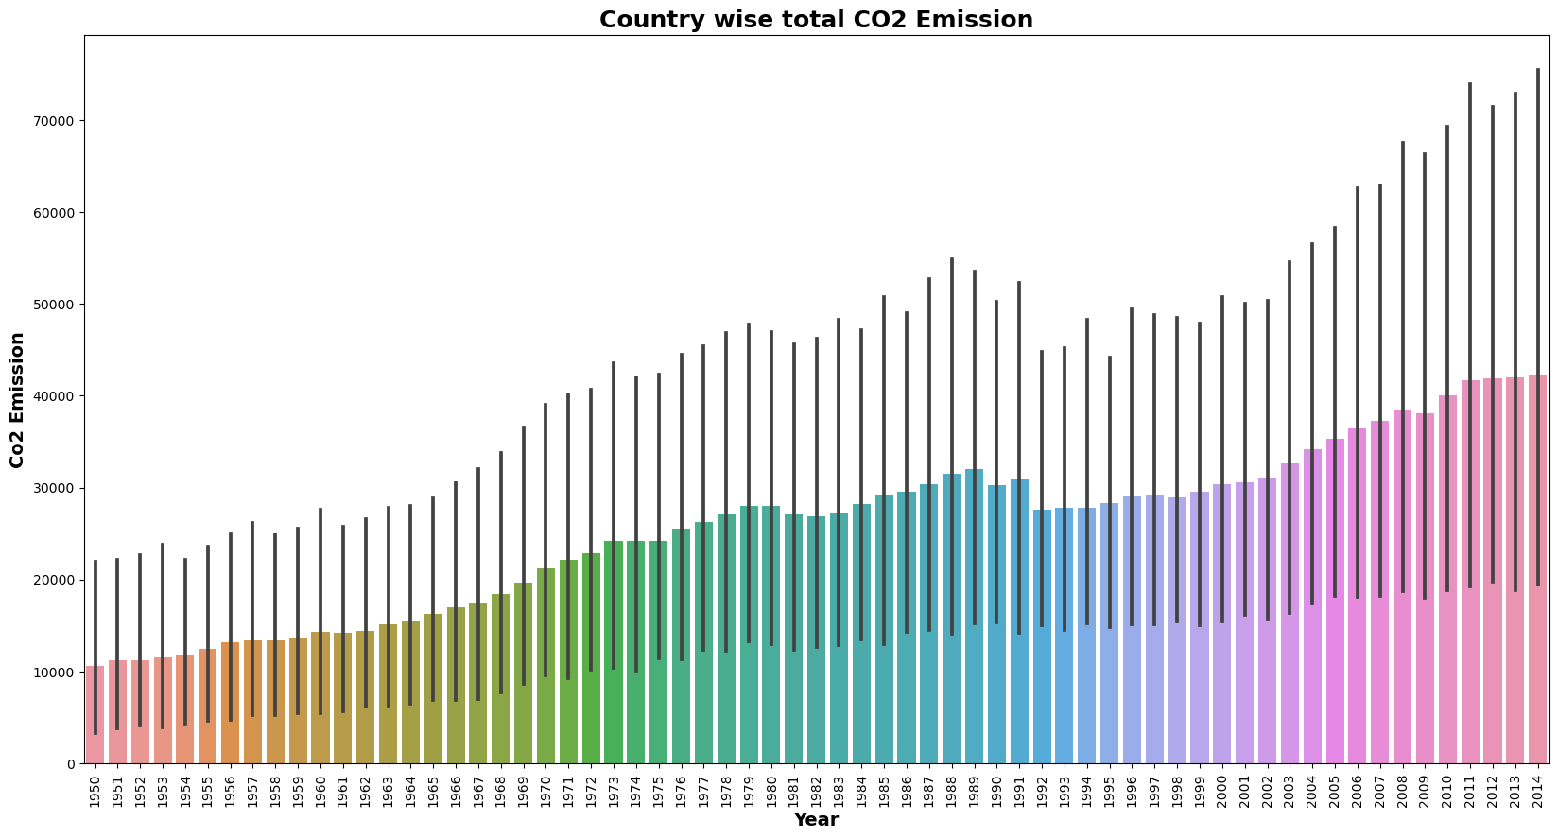
This bar plot shows total CO2 emissions by country

Slide 17
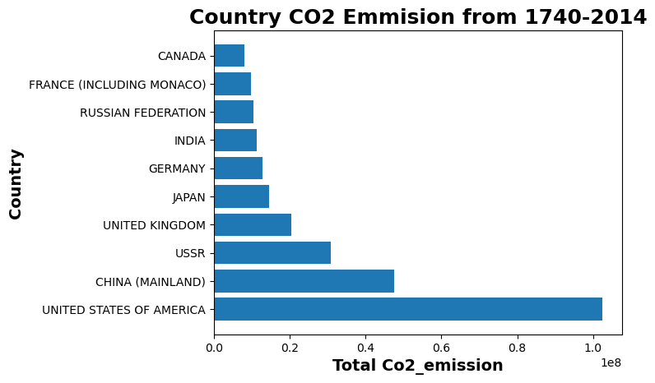
This graph shows CO2 emission of top 10 countries

Slide 18
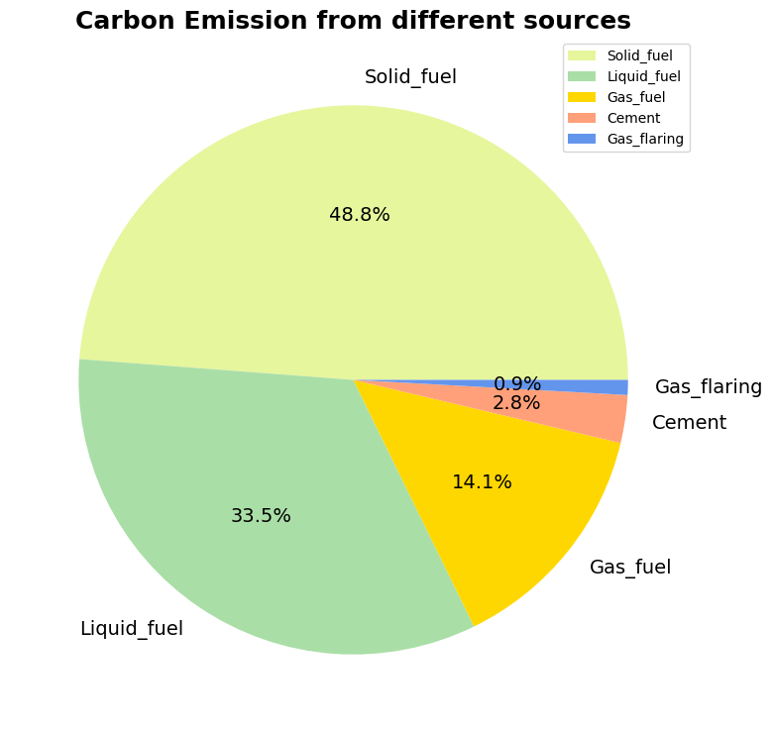
This pie chart explains the amount of carbon emission from different sources.

Slide 19

POST PROCESSING
We have written a Python program to store the finalized data in a database table.
We have chosen PostgreSQL for our database. PostgreSQL is a relational DBMS. It supports a wide range of data.
To store our dataset, we have used PyCharm to build a new table programmatically.
The pgAdmin application is used to see our database.
The below query allows us to fetch all the rows from the table.
SELECT * FROM public.tablename

Slide 20
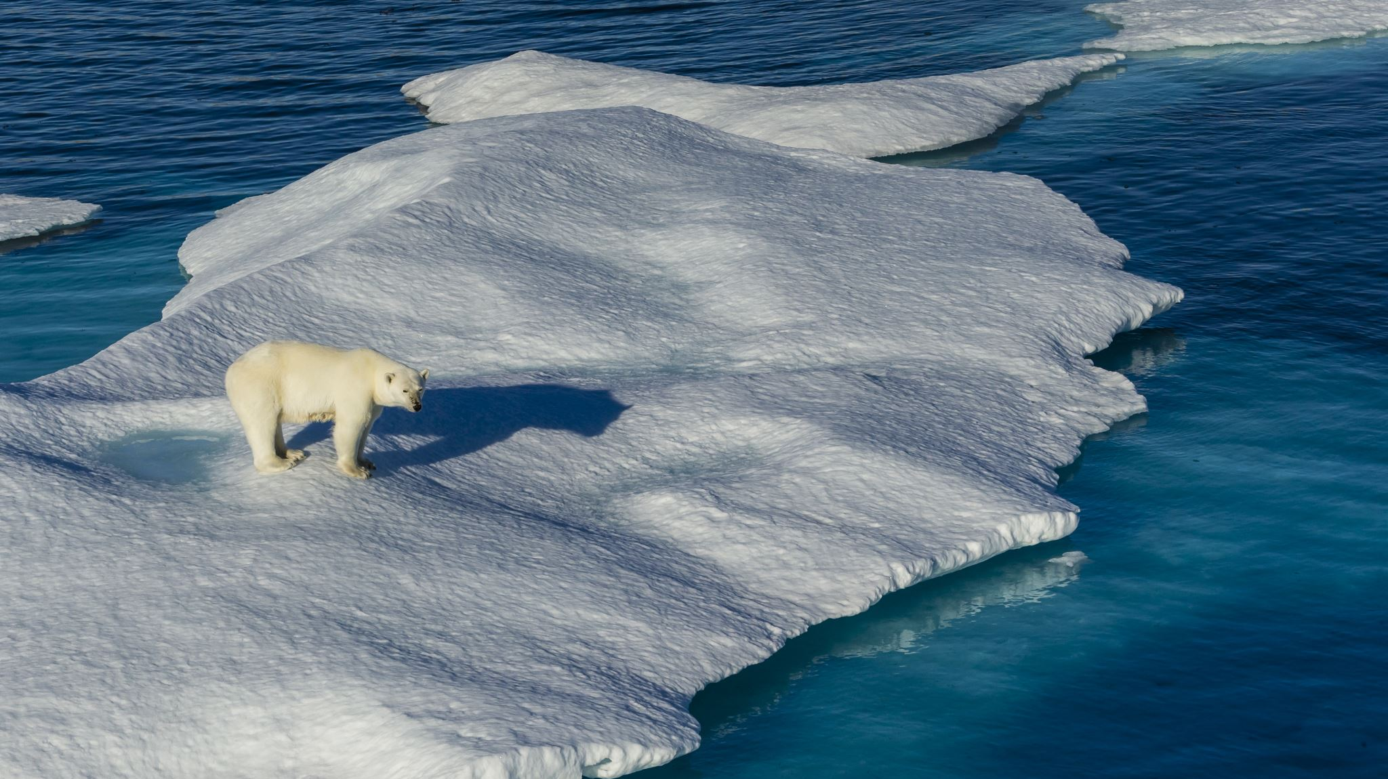
CONCLUSION
Sea level rise presents a critical and far-reaching consequence of climate change. As global temperatures climb, glaciers and polar ice sheets melt at an alarming rate, causing ocean expansion and a significant rise in sea levels.
For our analysis, we selected three datasets. The first one is the sea level rise dataset which gives information about the climate change occurring in the world due to rising sea levels. The second dataset is the air pollution dataset which gave insights about the different pollutants emitted by different countries and how much they contribute to the overall air quality index. Finally, the carbon emission dataset explored the trends in carbon emissions by different countries.
From our analysis of the three datasets, we were able to conclude that the sea level rises with the increase in temperature. Research suggests that sea levels could potentially rise by one meter by 2050, posing a significant threat to coastal communities and ecosystems worldwide.

Slide 21

Limitations AND FUTURE WORKS
Limitations:
There are a few limitations to this project. Sea level rise can be influenced by various factors of nature. Data unavailability is another limitation. The model requires high-quality data. Another main limitation is the model’s accuracy. Errors are always possible with these models because they are not perfect.
Future works:
Several areas are being explored for future work. Incorporating the quality of data is one of them. Quality of data helps to train the models accurately. Improving model accuracy helps us to predict accurate results.

Slide 22
THANK YOU

